Slide 1
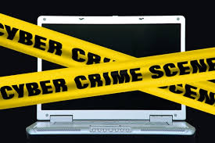
Cyber Crime

Slide 2
Introduction to Cyber Crime
The first recorded cyber crime took place in the year 1820! That is not surprising considering the fact that the abacus, which is thought to be the earliest form of a computer, has been around since 3500 B.C. in India, Japan and China.

Slide 3
Introduction to Cyber Crime
In 1820, Joseph-Marie Jacquard, a textile manufacturer in France, produced the
loom. This device allowed the repetition of a series of steps in the weaving of special
fabrics. This resulted in a fear amongst Jacquard's employees that their traditional employment and livelihood were being threatened

Slide 4
Introduction to Cyber Crime
Today computers have come a long way, with neural networks and nano-computing promising to turn every atom in a glass of water into a computer capable of performing a Billion operations per second

Slide 5
Introduction to Cyber Crime
Cyber crime is an evil having its origin in the growing dependence on computers in modern life. In a day and age when everything from microwave ovens and refrigerators to nuclear power plants is being run on computers, cyber crime has assumed rather sinister implications

Slide 6
Introduction to Cyber Crime
Major cyber crimes in the recent past include the Citibank rip off. US $ 10 million were fraudulently transferred out of the bank and into a bank account in Switzerland. A Russian hacker group led by Vladimir Kevin, a renowned hacker, perpetrated the attack. The group compromised the bank's security systems.

Slide 7
Defining Cyber Crime
Defining cyber crimes, as "acts that are punishable by the Information Technology Act" would be unsuitable as the Indian Penal Code also covers many cyber crimes, such as email spoofing and cyber defamation, sending threatening emails etc

Slide 8
Defining Cyber Crime
A simple yet sturdy definition of cyber crime would be "unlawful acts wherein the computer is either a tool or a target or both".
Let us examine the acts wherein the computer is a tool for an unlawful act.

Slide 9
Ransomware and Malware
The malware that asks for data to be recovered
by paying the ransom in the form of bitcoins.
Bitcoin is a cryptocurrency, a form of electronic cash. It is a decentralized digital currency without a central bank or single administrator that can be sent from user-to-user on the peer-to-peer bitcoin network without the need for intermediaries.

Slide 10
Bitcoins
Transactions are verified by network nodes through cryptography and recorded in a public distributed ledger called a blockchain. Bitcoin was invented by an unknown person or group of people using the name Satoshi Nakamoto and released as open-source software in 2009.
Bitcoins are created as a reward for a process known as mining. They can be exchanged for other currencies, products, and services.

Slide 11
Bitcoins
Bitcoin has been criticized for its use in illegal transactions, its high electricity consumption, price volatility, thefts from exchanges, and the possibility that bitcoin is an economic bubble. Bitcoin has also been used as an investment, although several regulatory agencies have issued investor alerts about bitcoin.

Slide 12
Data Breaches
Illegal acquisition of data following data breaches is a prominent threat“. The stolen information is often used for identity theft and other forms of fraud.

Slide 13
Cryptojacking
Attacks that aim to exploit computer users' bandwidth and processing power to mine for cryptocurrency are becoming more prevalent.
"Actual cryptomining malware works to the same effect, but can cripple a victims system by monopolizing their processing power."

Slide 14
Financial crimes
This would include cheating, credit card frauds, money laundering etc. To cite a recent case, a website offered to sell Alphonso mangoes at a throwaway price.
Distrusting such a transaction, very few people responded to or supplied the website
with their credit card numbers.

Slide 15
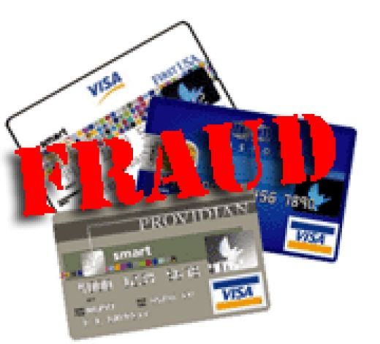
Credit Card Fraud

Slide 16
Credit Card Fraud
Thousands of people from all over the country responded and ordered mangoes by providing their credit card numbers. The owners of what was later proven to be a bogus website then fled taking the numerous credit card numbers and proceeded to spend huge amounts of money much to the chagrin of the card owners.

Slide 17
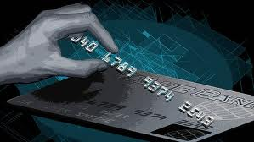

Slide 18
Credit Card Fraud
Credit card fraud is a wide-ranging term for theft and fraud committed using a credit card or any similar payment mechanism as a fraudulent source of funds in a transaction. The purpose may be to obtain goods without paying, or to obtain unauthorized funds from an account. Credit card fraud is also an adjunct to identity theft. According to the United States Federal Trade Commission, while identity theft had been holding steady for the last few years, it saw a 21 percent increase in 2008.

Slide 19
Stolen cards
Stolen cards can be reported quickly by cardholders, but a compromised account can be hoarded by a thief for weeks or months before any fraudulent use, making it difficult to identify the source of the compromise.

Slide 20
Stolen cards
When a credit card is lost or stolen, it may be utilized for illegal purchases until the holder notifies the issuing bank that the card is lost. Most issuing banks have free 24-hour telephone numbers to encourage prompt reporting. Still, it is possible for a thief to make unauthorized purchases on a card before its cancellation. Without other security measures, a thief could potentially purchase thousands of dollars in merchandise or services before the cardholder or the card issuer realize that the card is in the wrong hands.

Slide 21
Identity theft
Identity theft can be divided into two broad categories: Application fraud and account takeover.

Slide 22
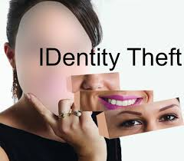

Slide 23
Application fraud
Application fraud happens when a criminal uses stolen or fake documents to open an account in someone else's name without authorization. Criminals may try to steal documents such as utility bills and bank statements to build up useful personal information. Alternatively, they may create counterfeit documents.

Slide 24
Account takeover
Account takeover happens when a criminal tries to take over another person's account, first by gathering information about the intended victim, and then contacting their card issuer while impersonating the genuine cardholder, and asking for mail to be redirected to a new address. The criminal then reports the card lost and asks for a replacement to be sent.

Slide 25
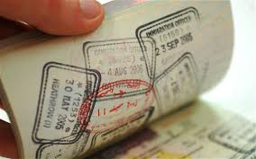

Slide 26
Skimming
Skimming is the theft of credit card information used in an otherwise legitimate transaction. The thief can procure a victim's credit card number using basic methods such as photocopying receipts or more advanced methods such as using a small electronic device (skimmer) to swipe and store hundreds of victims’ credit card numbers. Common scenarios for skimming are restaurants or bars where the skimmer has possession of the victim's credit card out of their immediate view.

Slide 27
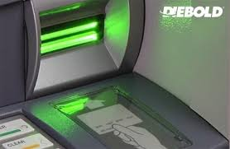

Slide 28
BIN attack
Credit cards are produced in BIN ranges. Where an issuer does not use random generation of the card number, it is possible for an attacker to obtain one good card number and generate valid card numbers by changing the last four numbers using a generator. The expiry date of these cards would most likely be the same as the good card.

Slide 29
Tele phishing
Scammers may obtain a list of individuals with their name and phone number luring the victim into thinking that they are speaking with a trusted organization handing over sensitive information such as credit card details.

Slide 30
Balance transfer checks
Some promotional offers include active balance transfer checks which may be tied directly to a credit card account. These are often sent unsolicited, and may occur as often as once per month by some financial institutions. In cases where checks are stolen from a victim's mailbox they can be used at point of sales locations thereby leaving the victim responsible for the losses. They are one path at times used by fraudsters.

Slide 31
Cyber pornography

Slide 32
Cyber pornography
This would include pornographic websites; pornographic magazines produced using computers (to publish and print the material) and the Internet (to download and transmit pornographic pictures, photos, writings etc). Recent Indian incidents revolving around cyber pornography include the Air Force Balbharati School case.

Slide 33
Cyber pornography
A student of the Air Force Balbharati School, Delhi, was teased by all his classmates for having a pockmarked face. Tired of the cruel jokes, he decided to get back at his tormentors. He scanned photographs of his classmates and teachers, morphed them with nude photographs and put them up on a website that he uploaded on to a free web hosting service.

Slide 34
Cyber pornography
In another incident, in Mumbai a Swiss couple would gather slum children and then would force them to appear for obscene photographs. They would then upload these photographs to websites specially designed for paedophiles.

Slide 35
Cyber pornography
The Internet enables people to access pornography more or less anonymously and to view it in the comfort and privacy of their homes. It also allows access to pornography by people whose access is otherwise restricted for legal or social reasons, such as children.

Slide 36
Cyber pornography
Usenet
Another free source of pornography on the Internet are the Usenet newsgroups that were the first home to such material. Newsgroups tend to be poorly organized and flooded with content that is off-topic or spam. Commercial software and websites are available that allow browsing the images or videos on newsgroups, sometimes with galleries of thumbnail images.

Slide 37
Cyber pornography
Peer-to-peer
Peer-to-peer file sharing networks provide another form of free access to pornography. While such networks have been associated largely with the illegal sharing of copyrighted music and movies, the sharing of pornography has also been a popular use for file sharing. Many commercial sites have recognized this trend and have begun distributing free samples of their content on peer-to-peer networks.

Slide 38
Sale of illegal articles
This would include sale of narcotics, weapons and wildlife etc., by posting information on websites, auction websites, and bulletin boards or simply by using email communication. E.g. many of the auction sites even in India are believed to be selling cocaine in the name of 'honey'.

Slide 39


Slide 40
Online gambling
There are millions of websites; all hosted on servers abroad, that offer online gambling. In fact, it is believed that many of these websites are actually fronts for money laundering.

Slide 41


Slide 42
Intellectual Property crimes

Slide 43
Cyber pornography
These include software piracy, copyright infringement, trademarks violations, theft of computer source code etc.

Slide 44
Email spoofing
A spoofed email is one that appears to originate from one source but actually has
been sent from another source. E.g. Pooja has an e-mail address pooja@asianlaws.org. Her enemy, Sameer spoofs her e-mail and sends obscene messages to all her acquaintances. Since the e-mails appear to have originated from Pooja, her friends could take offence and relationships could be spoiled for life.

Slide 45
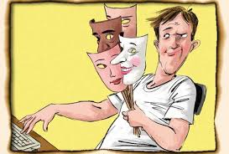

Slide 46
Email Spoofing
Email spoofing can also cause monetary damage. In an American case, a teenager made millions of dollars by spreading false information about certain companies whose shares he had short sold.

Slide 47
Email Spoofing
This misinformation was spread by sending spoofed emails, purportedly from news agencies like Reuters, to share brokers and investors who were informed that the companies were doing very badly. Even after the truth came out the values of the shares did not go back to the earlier levels and thousands of investors lost a lot of money.

Slide 48
Forgery
Counterfeit currency notes, postage and revenue stamps, mark sheets etc can be forged using sophisticated computers, printers and scanners. Outside many colleges across India, one finds touts soliciting the sale of fake mark sheets or even certificates.

Slide 49
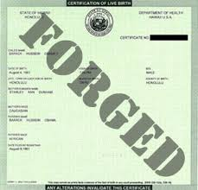

Slide 50
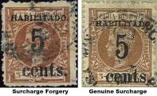

Slide 51
Cyber Defamation
This occurs when defamation takes place with the help of computers and / or the
Internet. E.g. someone publishes defamatory matter about someone on a website or
sends e-mails containing defamatory information to all of that person's friends.

Slide 52
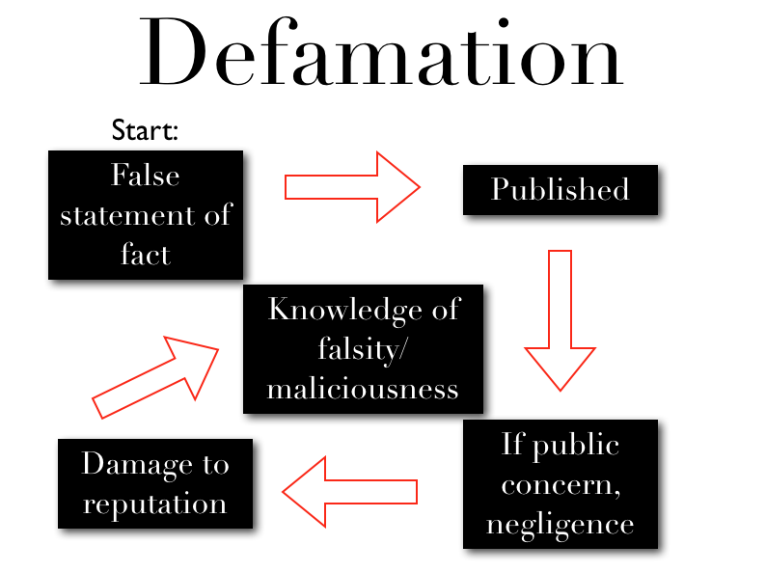

Slide 53


Slide 54
Defamation
In a recent occurrence, Surekha (names of people have been changed), a young girl was about to be married to Suraj. She was really pleased because despite it being an arranged marriage, she had liked the boy. He had seemed to be open-minded and pleasant. Then, one day when she met Suraj, he looked worried and even a little upset. He was not really interested in talking to her

Slide 55
Defamation
When asked he told her that, members of his family had been receiving e-mails that contained malicious things about Surekha's character. Some of them spoke of affairs, which she had in the past. He told her that, his parents were justifiably very upset and were also considering breaking off the engagement. Fortunately, Suraj was able to prevail upon his parents and the other elders of his house to approach the police instead of blindly believing what was contained in the mails

Slide 56
Defamation
During investigation, it was revealed that the person sending those e-mails was none other than Surekha's stepfather. He had sent these e-mails so as to break up the marriage. The girl's marriage would have caused him to lose control of her property of which he was the guardian till she got married.

Slide 57
Cyber stalking
The Oxford dictionary defines stalking as "pursuing stealthily". Cyber stalking involves following a person's movements across the Internet by posting messages (sometimes threatening) on the bulletin boards frequented by the victim, entering the chat-rooms frequented by the victim, constantly bombarding the victim with emails etc

Slide 58


Slide 59
Unauthorized access to computer systems or networks
This activity is commonly referred to as hacking. The Indian law has however given a
different connotation to the term hacking, so we will not use the term "unauthorized
access" interchangeably with the term "hacking

Slide 60
Theft of information contained in electronic form
This includes information stored in computer hard disks, removable storage media etc.

Slide 61
Email bombing
Email bombing refers to sending a large number of emails to the victim resulting in the victim's email account (in case of an individual) or mail servers (in case of a company or an email service provider) crashing

Slide 62


Slide 63
Email Spoofing
In one case, a foreigner who had been residing in Simla, India for almost thirty years wanted to avail of a scheme introduced by the Simla Housing Board to buy land at lower rates. When he made an application it was rejected on the grounds that the schemes was available only for citizens of India. He decided to take his revenge. Consequently he sent thousandsof mails to the Simla Housing Board and repeatedly kept sending e-mails till their servers crashed.

Slide 64
Data diddling
This kind of an attack involves altering raw data just before it is processed by a computer and then changing it back after the processing is completed. Electricity Boards in India have been victims to data diddling programs inserted when private parties were computerizing their systems.

Slide 65
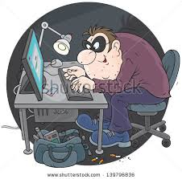

Slide 66
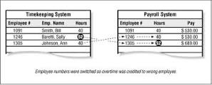

Slide 67
Salami attacks
These attacks are used for the commission of financial crimes. The key here is to make the alteration so insignificant that in a single case it would go completely unnoticed. E.g. a bank employee inserts a program, into the bank's servers, that deducts a small amount of money (say Rs. 5 a month) from the account of every
customer. No account holder will probably notice this unauthorized debit, but the bank employee will make a sizable amount of money every month

Slide 68
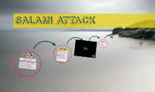

Slide 69
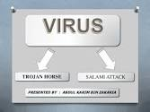

Slide 70
Denial of Service attack
This involves flooding a computer resource with more requests than it can handle. This causes the resource (e.g. a web server) to crash thereby denying authorized users the service offered by the resource. Another variation to a typical denial of service attack is known as a Distributed Denial of Service (DDoS) attack wherein the perpetrators are many and are geographically widespread

Slide 71
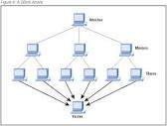

Slide 72
Denial-of-service attacks have had an impressive history having, in the past, brought down websites like Amazon, CNN, Yahoo and eBay.

Slide 73
Virus / worm attacks
Viruses are programs that attach themselves to a computer or a file and then circulate themselves to other files and to other computers on a network. They usually affect the data on a computer, either by altering or deleting it. Worms, unlike viruses do not need the host to attach themselves to.

Slide 74
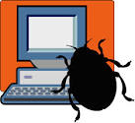

Slide 75
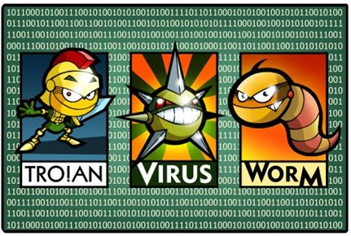

Slide 76
They merely make functional copies of themselves and do this repeatedly till they eat up all the available space on a computer's memory. The VBS_LOVELETTER virus (better known as the Love Bug or the ILOVEYOU virus) was reportedly written by a Filipino undergraduate

Slide 77
In May 2000, this deadly virus beat the Melissa virus hollow - it became the world'smost prevalent virus. It struck one in every five personal computers in the world.
When the virus was brought under check the true magnitude of the losses was incomprehensible. Losses incurred during this virus attack were pegged at US $ 10 Billion.

Slide 78
Logic bombs
These are event dependent programs. This implies that these programs are created
to do something only when a certain event (known as a trigger event) occurs. E.g.
even some viruses may be termed logic bombs because they lie dormant all through
the year and become active only on a particular date (like the Chernobyl virus).

Slide 79


Slide 80
Trojan attacks
A Trojan as this program is aptly called, is an unauthorized program which functions
from inside what seems to be an authorized program, thereby concealing what it is
actually doing.

Slide 81
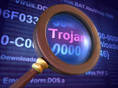

Slide 82
Trojan Attacks
There are many simple ways of installing a Trojan in someone's computer. To cite and example, two friends Rahul and Mukesh (names changed), had a heated argument over one girl, Radha (name changed) whom they both liked. When the girl, asked to choose, chose Mukesh over Rahul, Rahul decided to get revenge.

Slide 83
Trojan Attacks
On the 14th of February, he sent Mukesh a spoofed e-card, which appeared to have come
from Radha's mail account. The e-card actually contained a Trojan. As soon as Mukesh opened the card, the Trojan was installed on his computer. Rahul now had complete control over Mukesh's computer and proceeded to harass him thoroughly.

Slide 84
Internet time thefts
This connotes the usage by an unauthorized person of the Internet hours paid for by
another person. In a case reported before the enactment of the Information
Technology Act, 2000 Colonel Bajwa, a resident of New Delhi, asked a nearby net
café owner to come and set up his Internet connection.

Slide 85
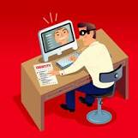

Slide 86
Web jacking
This occurs when someone forcefully takes control of a website (by cracking the
password and later changing it). The actual owner of the website does not have any
more control over what appears on that website In a recent incident reported in the
USA the owner of a hobby website for children received an e-mail informing her that
a group of hackers had gained control over her website.

Slide 87


Slide 88
Theft of computer system
This type of offence involves the theft of a computer, some part(s) of a computer or
a peripheral attached to the computer

Slide 89
Physically damaging a computer system
This crime is committed by physically damaging a computer or its peripherals

Slide 90
